Slide 1
CS6240 PROjeCT
Biyanta Shah
Sravani Beeram

Slide 2
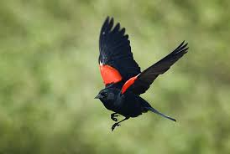

Problem

Slide 3

Solution
MLLIB – Random Forests
Why Random Forest?
Parameters

Slide 4
Features used for training
Core covariates
Included features related to climate, ecosystem and human population
Checklist
Included features describing the sampling events
Extended covariates
Considered features relating to habitat of the species

Slide 5
Code Design
Labeled data
Preprocessing
Split the data
70%
30%
Train model
Test model
Highest Accuracy: 84.51 %
Max Depth: 18
Number of trees: 15
Unlabeled data
Prediction results

Slide 6
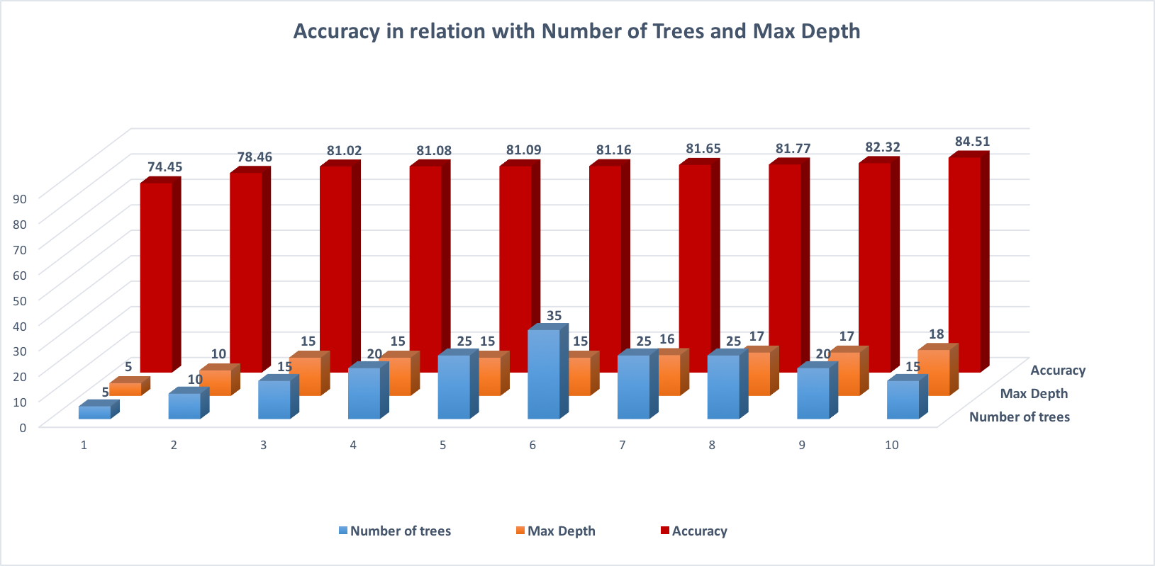

Slide 7
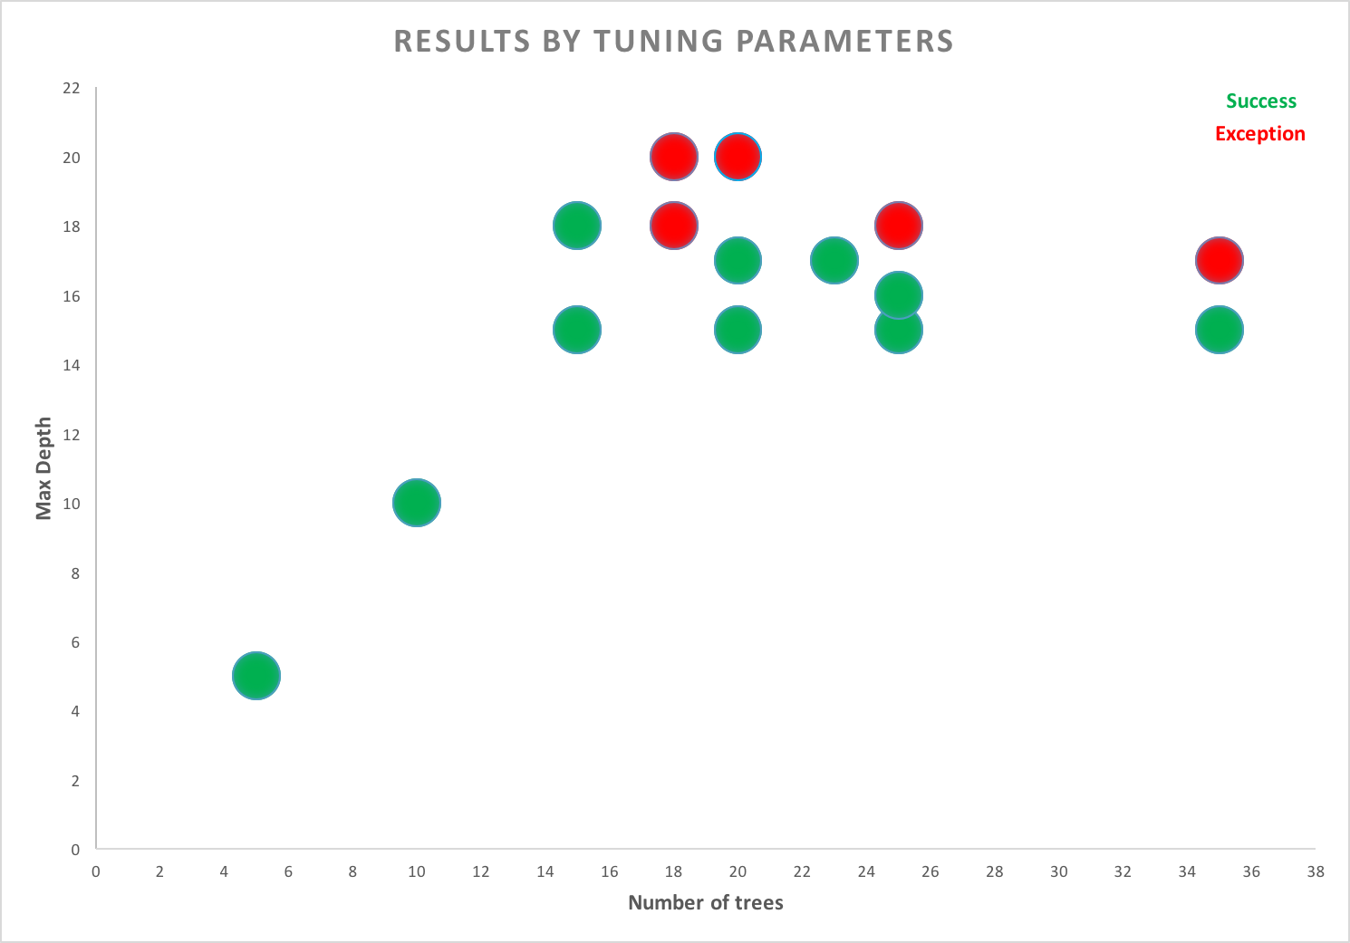

Slide 8
References
https://spark.apache.org/docs/latest/mllib-ensembles.html
https://databricks.com/blog/2015/01/21/random-forests-and-boosting-in-mllib.html
http://pages.cs.wisc.edu/~matthewb/pages/notes/pdf/ensembles/RandomForests.pdf
http://www.zhiyuanlin.com/uploads/5/8/8/1/58812849/improvingmllib.pdf
https://www.analyticsvidhya.com/blog/2016/04/complete-tutorial-tree-based-modeling-scratch-in-python/

Slide 9
Thank you !

